Slide 1
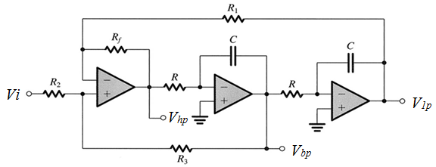
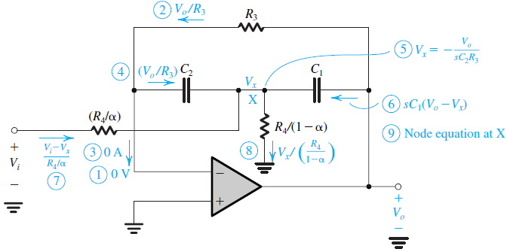
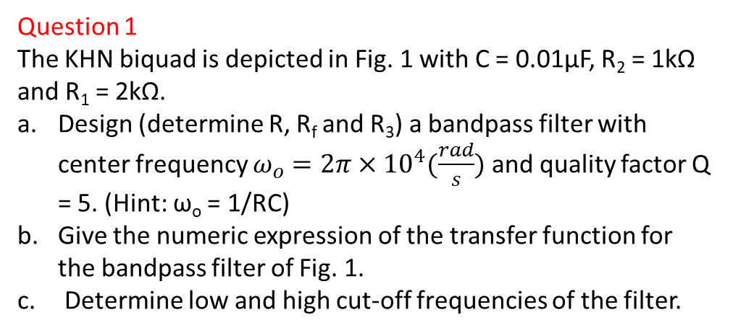
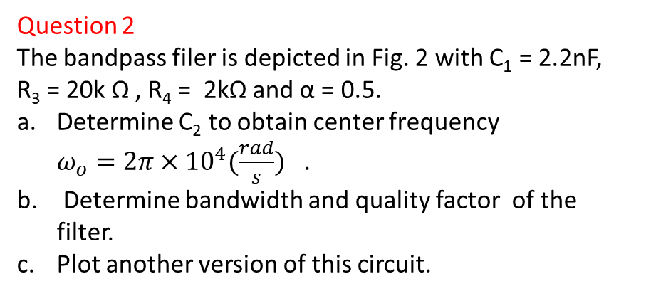
Quiz 7.2
Deadline: June 12, 2020
Question 1
The KHN biquad is depicted in Fig. 1 with C = 0.01μF, R₂ = 1kΩ and R₁ = 2kΩ.
Design (determine R, R_{f} and R₃) a bandpass filter with center frequency $ω_{o}=2π×{10}^{4}(\frac{rad}{s})$ and quality factor Q = 5. (Hint: ω_{o} = 1/RC)
Give the numeric expression of the transfer function for the bandpass filter of Fig. 1.
Determine low and high cut-off frequencies of the filter.
Fig. 1
Question 2
The bandpass filer is depicted in Fig. 2 with C₁ = 2.2nF, R₃ = 20k Ω , R₄ = 2kΩ and α = 0.5.
Determine C₂ to obtain center frequency ${ω_{o}=2π×{10}^{4}(\frac{rad}{s})}_{}$.
Determine bandwidth and quality factor of the filter.
Plot another version of this circuit.
Fig. 2

